Slide 1
CS5250: Advanced Operating Systems
AY2021-2022 Semester 2
Weng-Fai Wong
COM2-03-56
wongwf@nus.edu.sg

Slide 2
Objectives of CS5250
Understand the user needs and environmental constraints that drive the design of operating systems
Understand the overall structure and design of any modern operating system especially in how their interact
Understand the tradeoffs in the core algorithms and extend or modify them according to user needs
Be equipped to take on more complex systems by being exposed to some of workings of actual systems

Slide 3
Syllabus
Operating system design strategies including microkernels, mobile, embedded and real-time operating systems and the component’s interfaces
Priority and resource allocation strategies
Scheduling algorithms
Naming, protection and security
User interface, windowing systems
Distributed and shared objects
File system implementations including network and distributed file systems
Failure and recovery
Virtualization and the Internet-ready OS

Slide 4
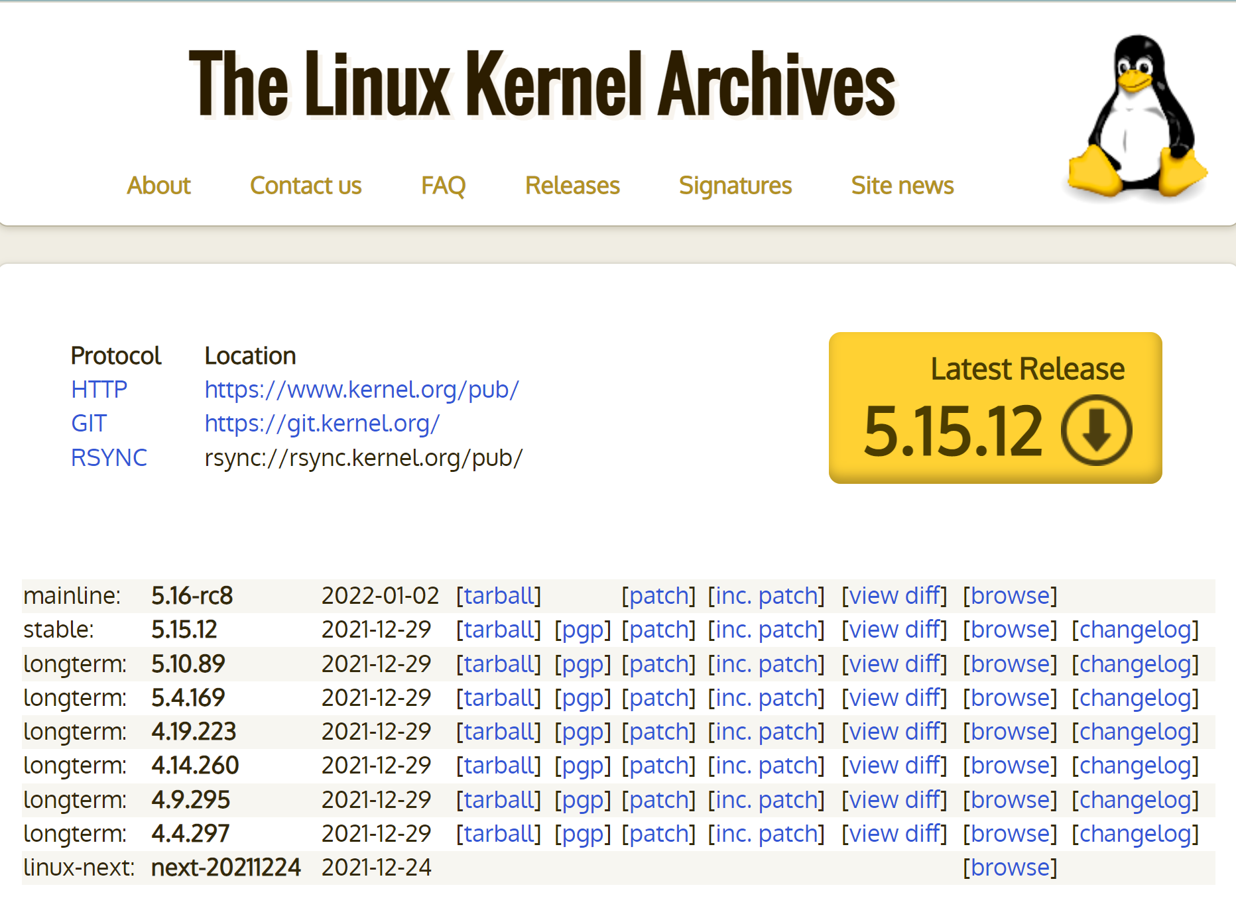
But how exactly will we do it?
The challenge: we can’t write a complex OS from scratch
Implementing the algorithms we will discuss often requires a lot of infrastructure support
Deep dive into x86-Linux kernel source code
We will use Linux kernel 5.15.12
Use hands-on assignment to advance our knowledge

Slide 5
Prerequisites
C/C++ programming
X86 assembly programming (if possible)
A prior undergraduate course in operating systems

Slide 6
Assessments
60% continual assessment
Pop quizzes
No tutorial
40% final assessment
Final assessment in the afternoon of Friday, 6 May 2022
4 take-home individual assignments

Slide 7
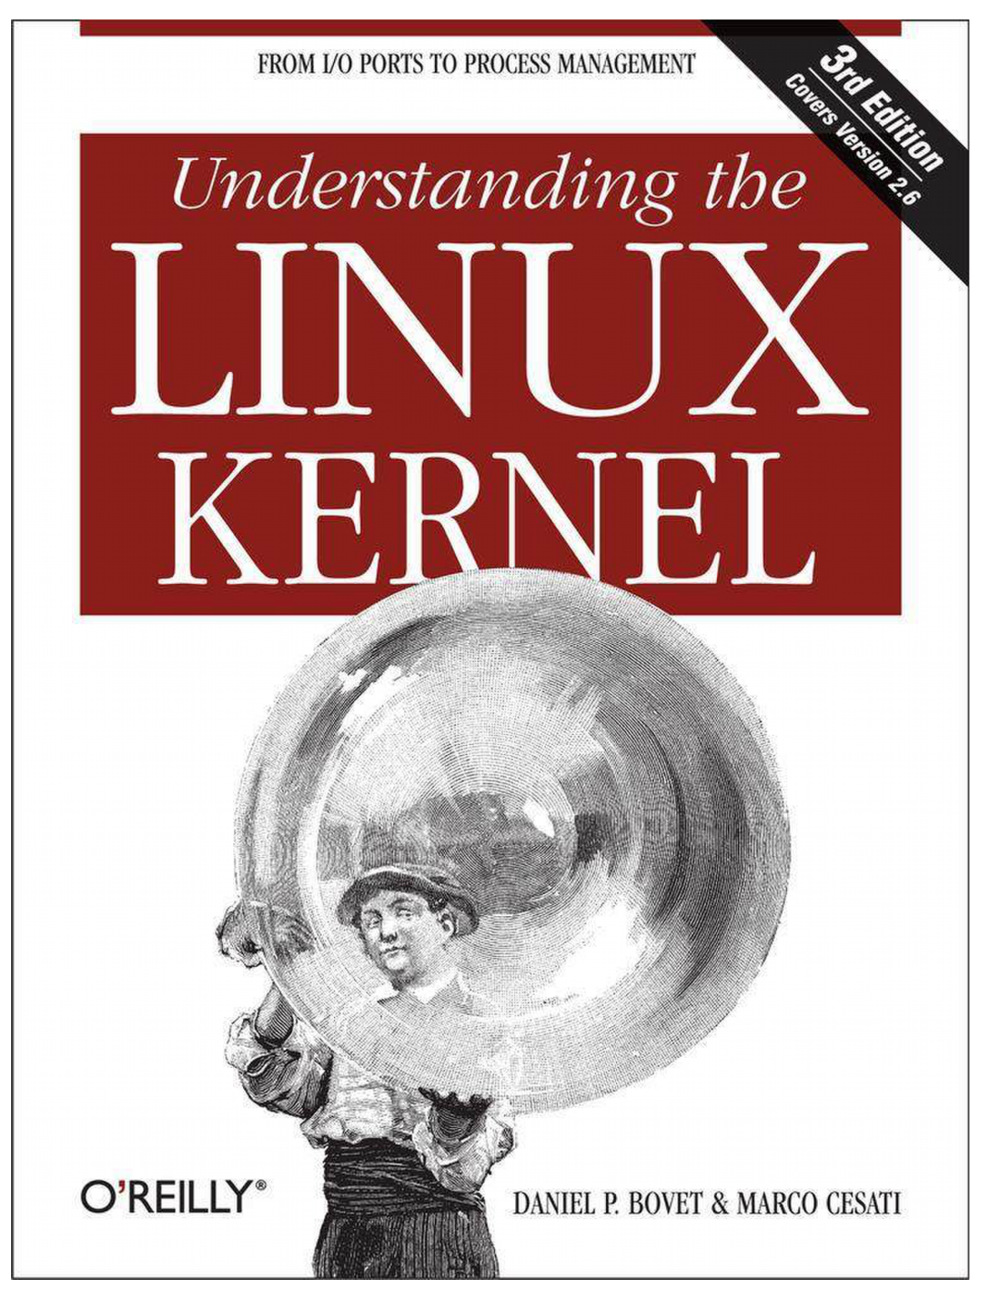
Reference Text

Slide 8
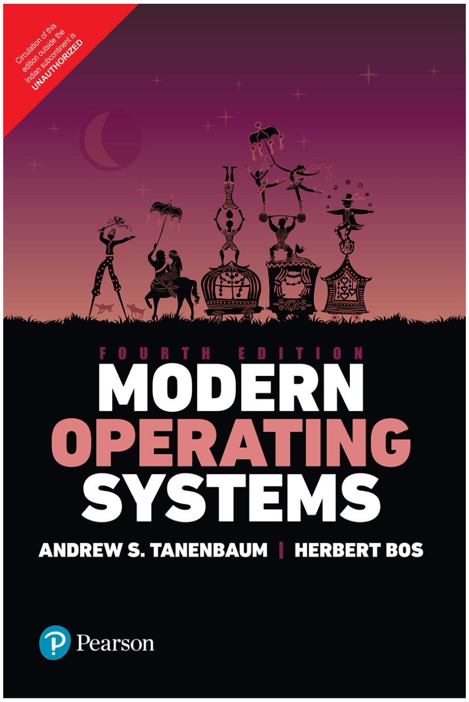
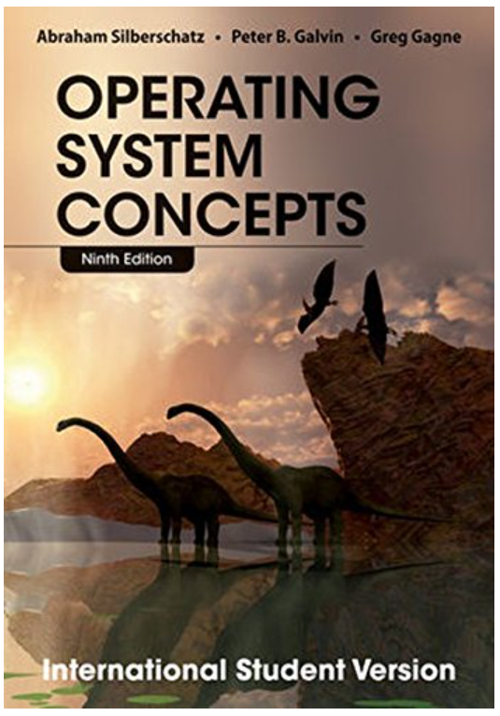
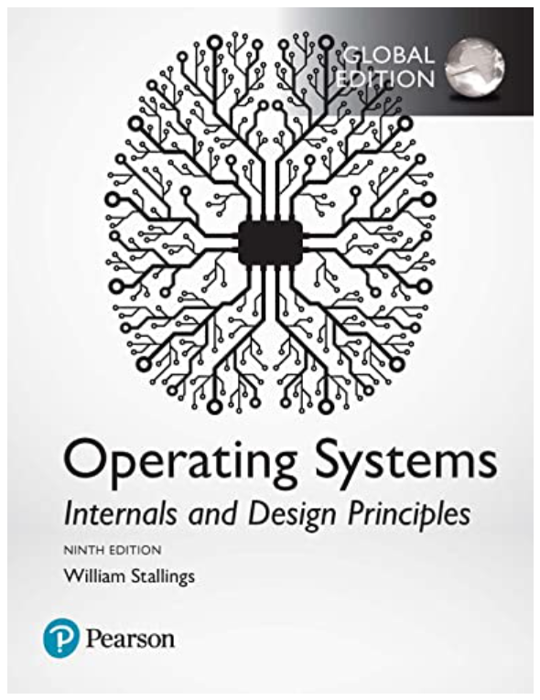
Supplementary texts (revision)
https://www.amazon.sg/Operating-Systems-Internals-Design-Principles/dp/1292214295
https://www.amazon.sg/Modern-Operating-Systems-Andrew-Tanenbaum/dp/9332575770
https://www.amazon.sg/Operating-System-Concepts-Abraham-Silberschatz/dp/1118093755
Also:
https://pages.cs.wisc.edu/~remzi/OSTEP/

Slide 9
Introduction

Slide 10
What is an Operating Systems?
Low level programs that sits between the hardware and user applications

Slide 11
Functions of an operating systems
Manage a computer system’s resources
Provide user interface
Provide services for applications

Slide 12
Key system resources
Processors (cores)
Memory
Input/Output devices
Keyboard, mouse, monitor, and other human interface devices
Graphics card
Disk storage
Network
Printers, USB devices etc.
Data and storage

Slide 13
Other key services
Hardware abstraction
Protection
Sharing and data exchange
Caching
Interrupt handling

Slide 14
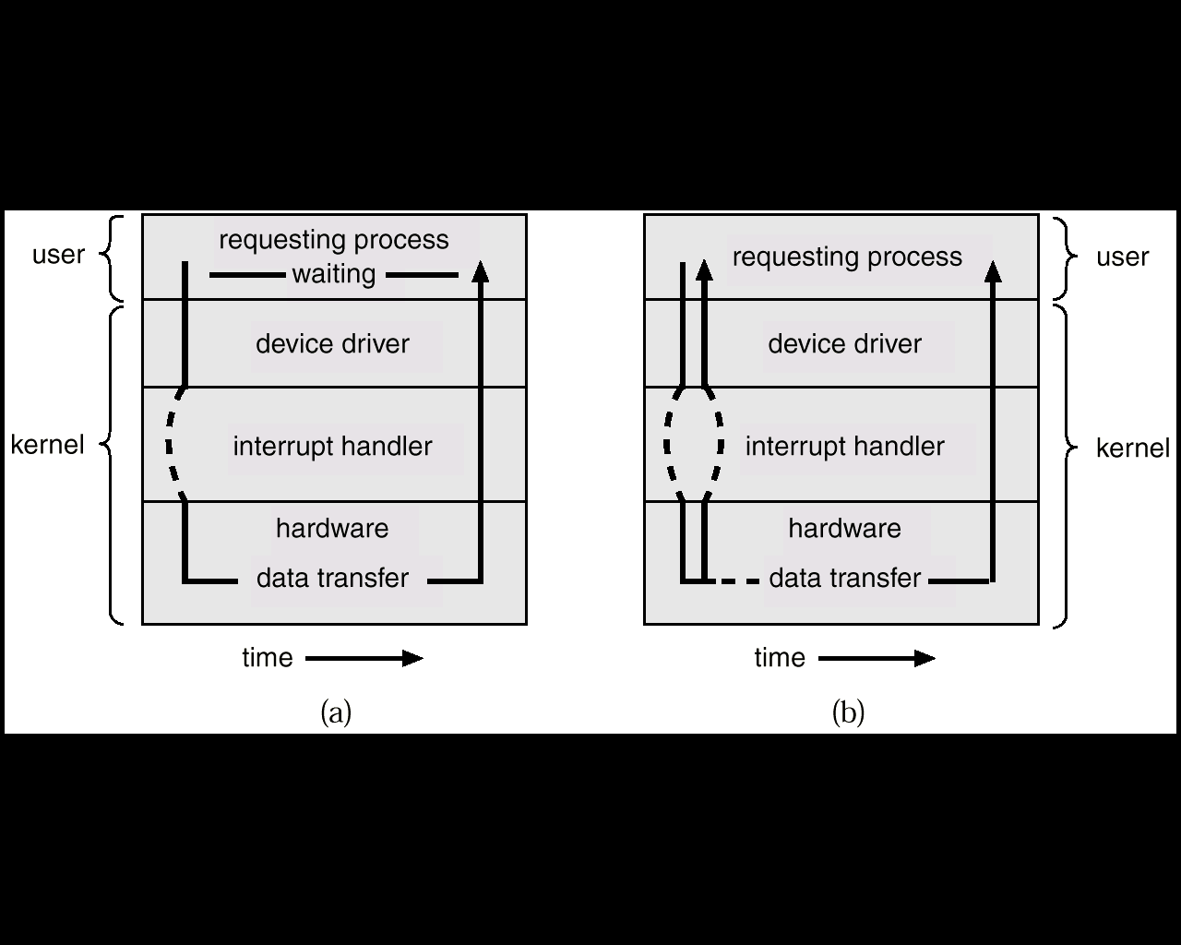
Hardware abstraction
Provide regulated access to hardware
Manufacturers provide “drivers” – software interfaces
Provide book-keeping services

Slide 15
Protection
Protect users (especially in a multiuser environment) against other users who may be malicious or plain ignorant
At least two modes of protection enabled with hardware support:
User mode
Supervisor mode (root access)

Slide 16
Sharing
Isolation vs sharing
Need to establish that the sharing is legitimate
Inter-process communication
Via networking

Slide 17
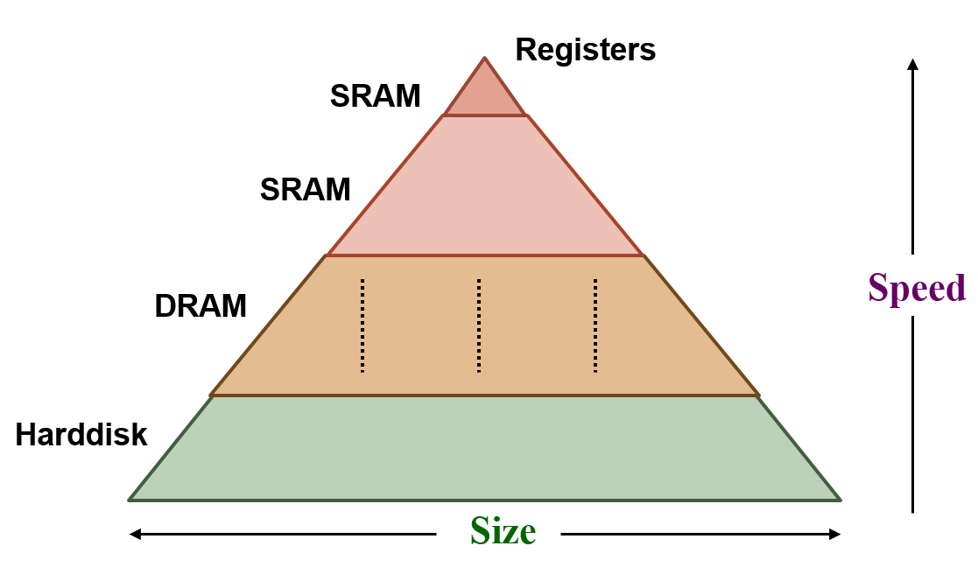
Caching
Caching is ubiquitious
To bridge differences in speeds and capacities
Hardware caching
TLB, processor cache, disk caches
Software caching
Page cache

Slide 18
Interrupt handling
Interrupts – asynchronous to program execution
caused by external events
may be handled between instructions, so can let the instructions currently active in the pipeline complete before passing control to the OS interrupt handler
simply suspend and resume user program
Traps (Exception) – synchronous to program execution
caused by internal events
condition must be remedied by the trap handler for that instruction, so much stop the offending instruction midstream in the pipeline and pass control to the OS trap handler
the offending instruction may be retried (or simulated by the OS) and the program may continue or it may be aborted

Slide 19
Interrupt handling – examples
Arithmetic overflow
Undefined instruction
TLB or page fault
Segmentation fault
I/O service request
Hardware malfunction
Timer

Slide 20
Key Operating Systems

Slide 21
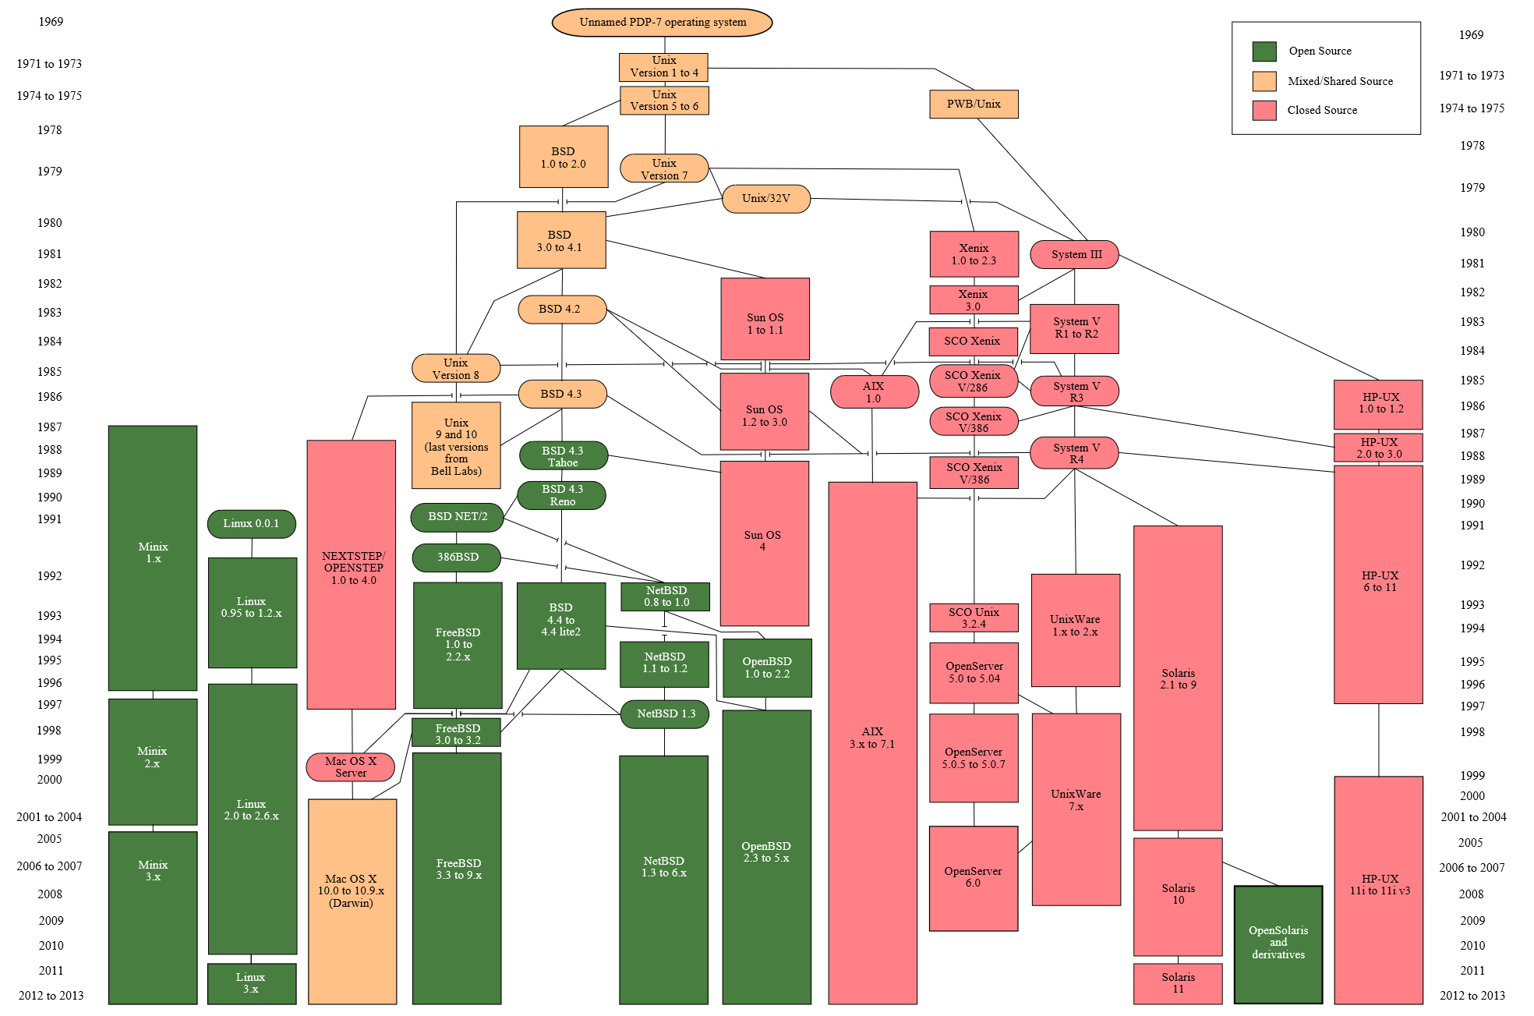
Unix

Slide 22
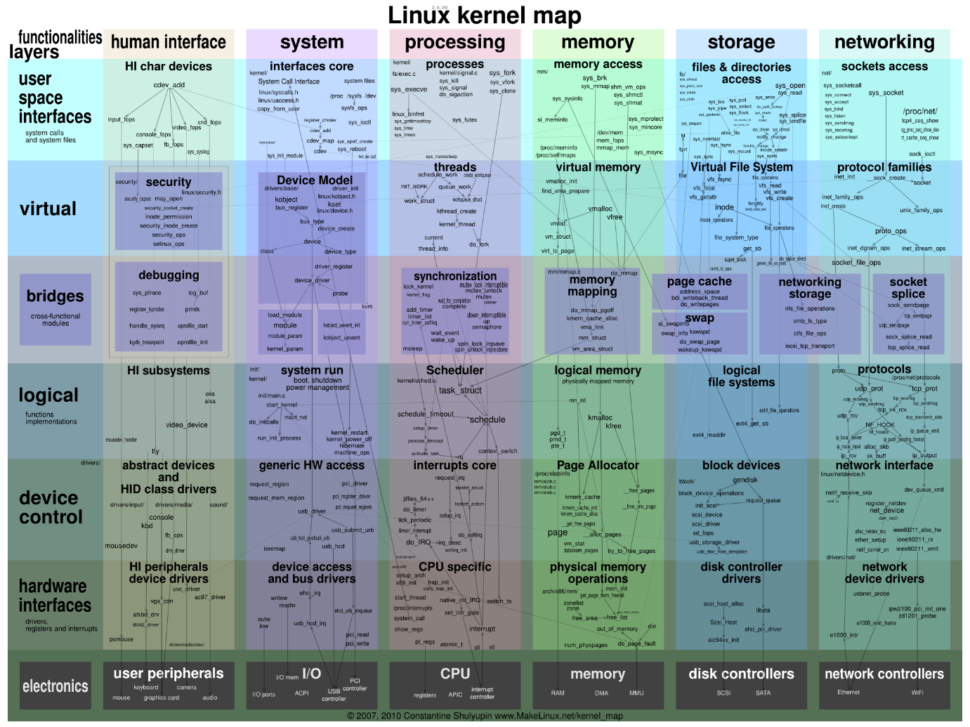
Linux

Slide 23
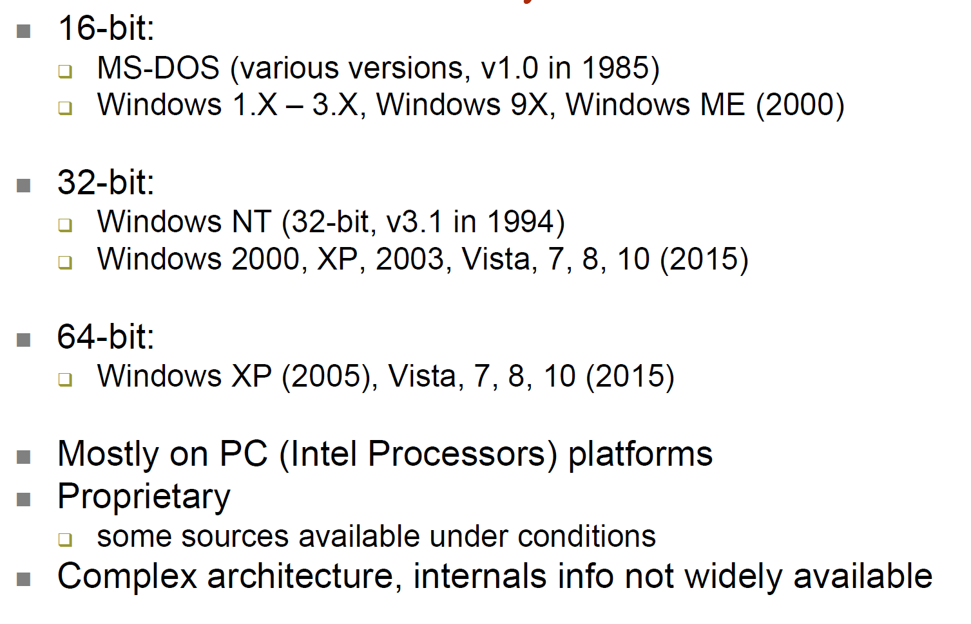
Microsoft Windows

Slide 24
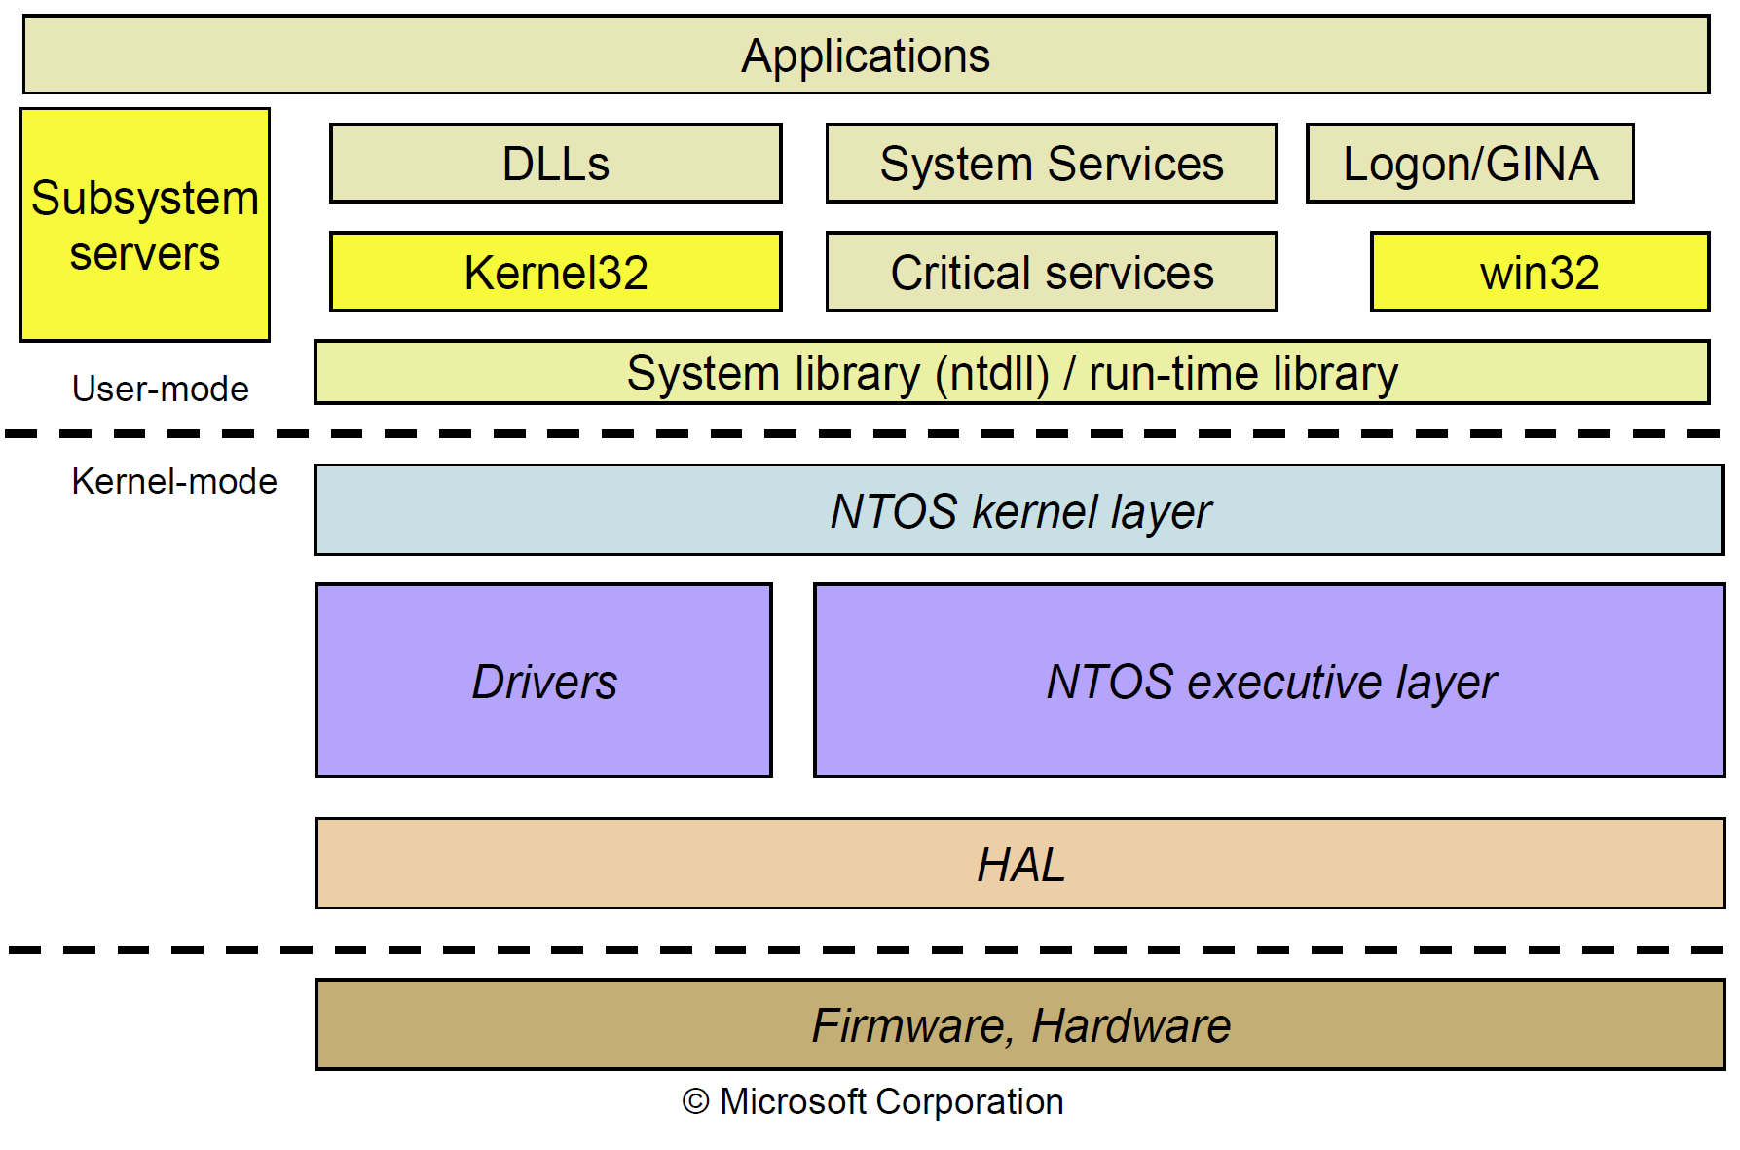
Microsoft Windows

Slide 25
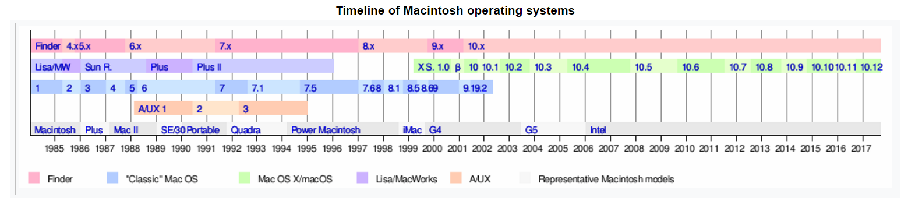
MacOS

Slide 26
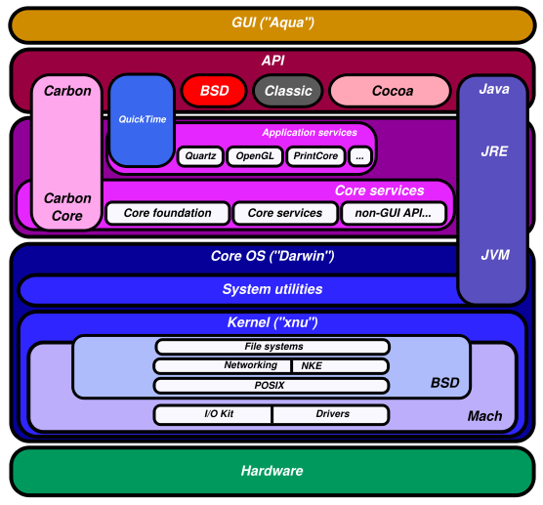
MacOS

Slide 27
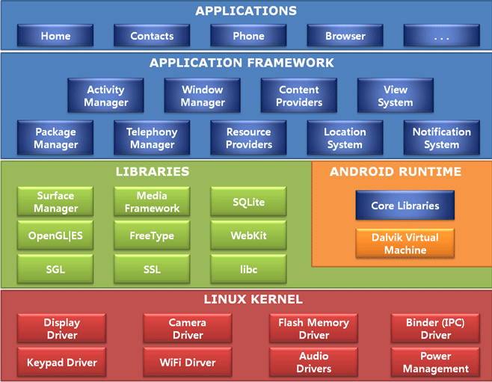
Android OS

Slide 28
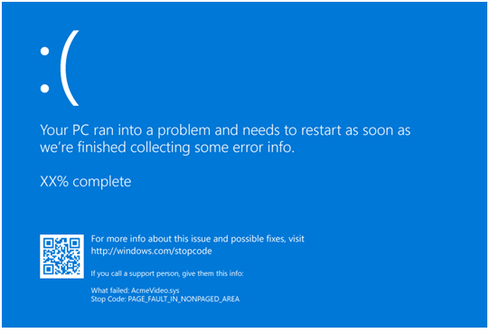
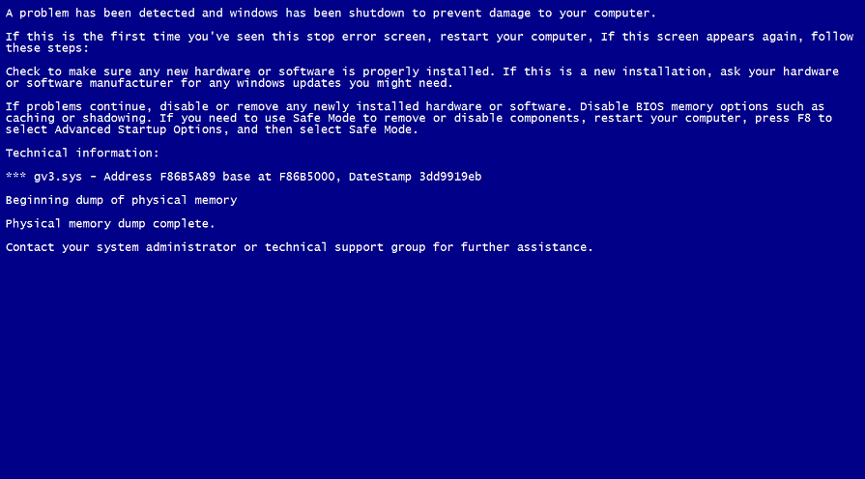
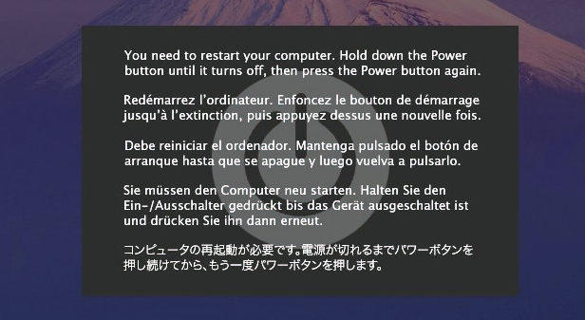
The Show Stopper

Slide 29
Characteristics of OSes

Slide 30
Types of OS
Batch
Data centers
Interactive
PCs
Mobile devices
Real-time
Embedded systems
Robots
Hybrid

Slide 31
Structures of OS
Monolithic
Microkernel
Network OS
Distributed OS
Exokernels

Slide 32
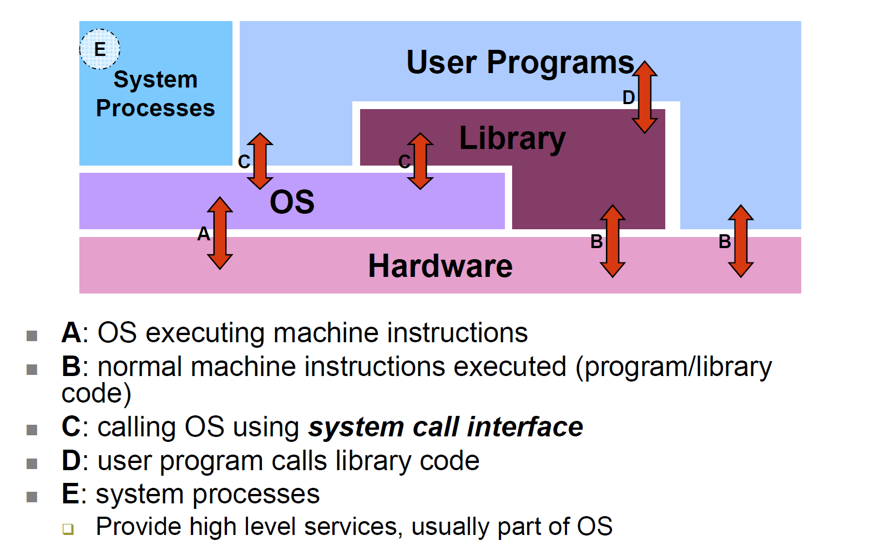
A Generic OS

Slide 33
Monolithic Design
Usually a single large process
Runs in a single address space – the kernel space
Often a single binary file loaded at boot time
With other processes and files such as drivers assisting

Slide 34
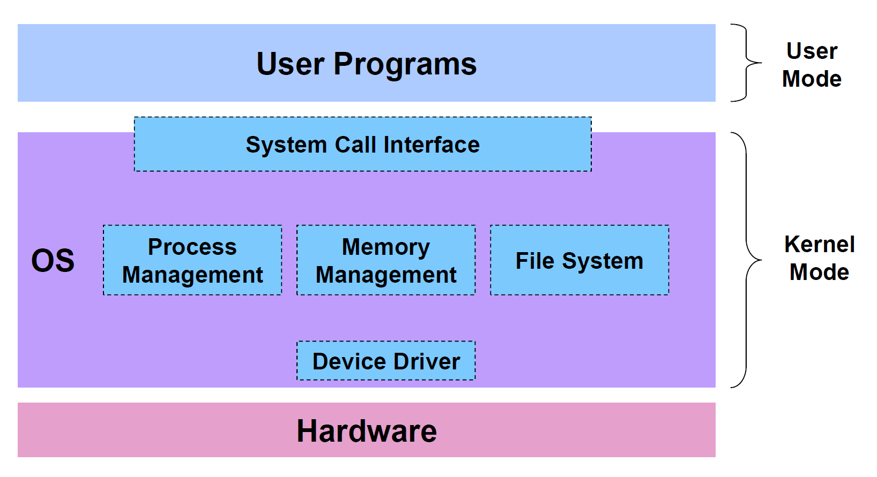
Monolithic Design

Slide 35
Microkernel
Small kernel supporting minimal essential services
IPC, virtual memory, processing scheduling, interrupt handling, protection
All other services handled by separate user level server processes
Applications request for services from the server processes

Slide 36
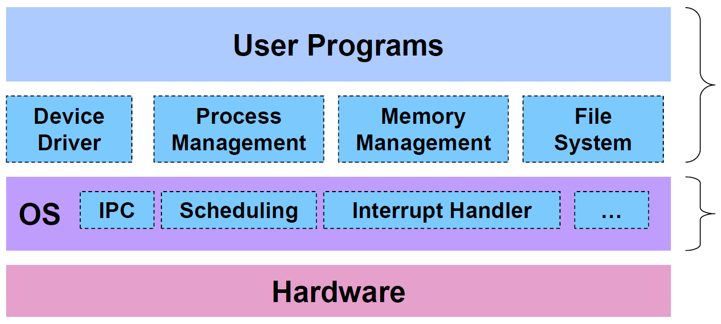
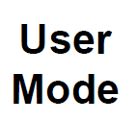
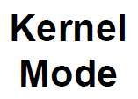
Microkernel Design
Example: MINIX 3 – kernel only 12,000 lines

Slide 37
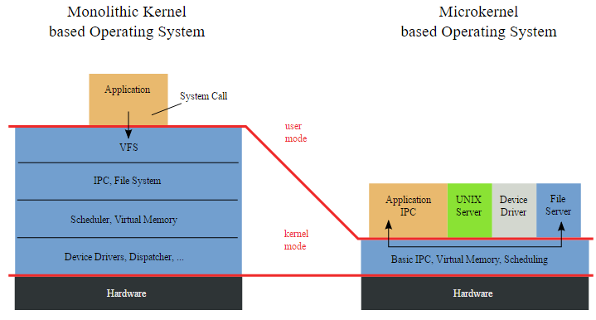
Microkernel – using IPC

Slide 38
Microkernel pros and cons
Security advantage
Principle of Least Privilege
“only enough privilege to do what is required – and no more”
A problem bugging Windows
Performance disadvantage
IPC requires 2 OS kernel crossing and process scheduling

Slide 39
Exokernels
Squeeze kernel even further by removing more of its management duties
Give applications direct access to hardware via libraries
Experimental

